Slide 1
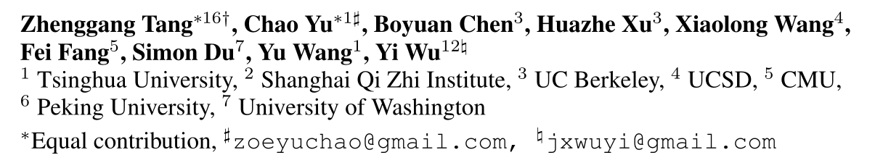
Discovering Diverse Multi-Agent Strategic Behavior via Reward Randomization
ICLR 2021
张钰波
2021.06.07

Slide 2
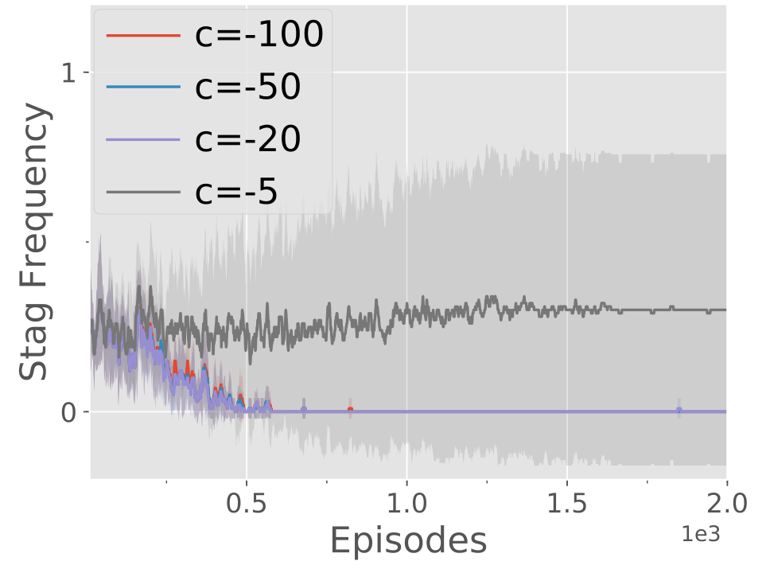
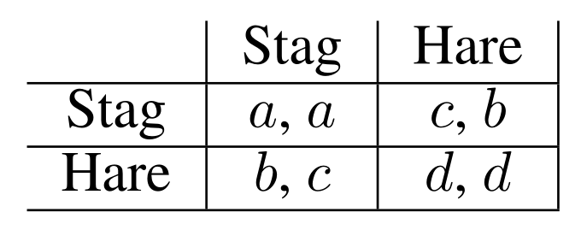
Background
The existence of multiple NEs is extremely common in many multi-agent games.
PPO in stag hunt, with a=4, b=3, d=1 and various c (10 seeds)

Slide 3
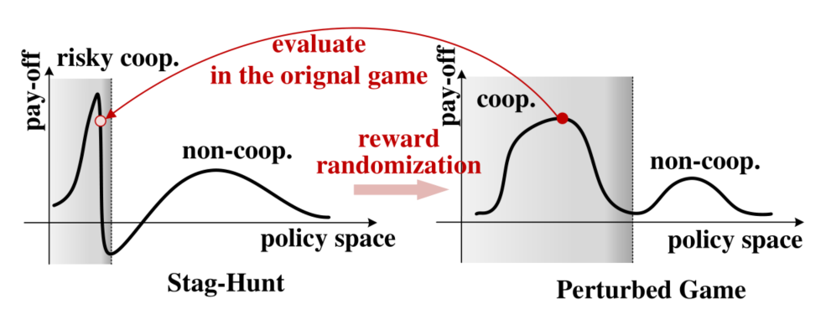
Motivation
In a game with extreme reward setting, reinforcement learning is usually difficult to explore the optimal strategy.
Reward Randomization (RR)
Reward-Randomized Policy Gradient (RPG)

Slide 4

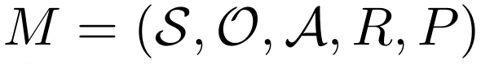
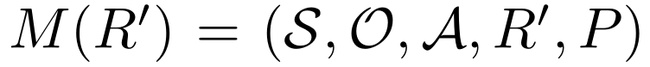
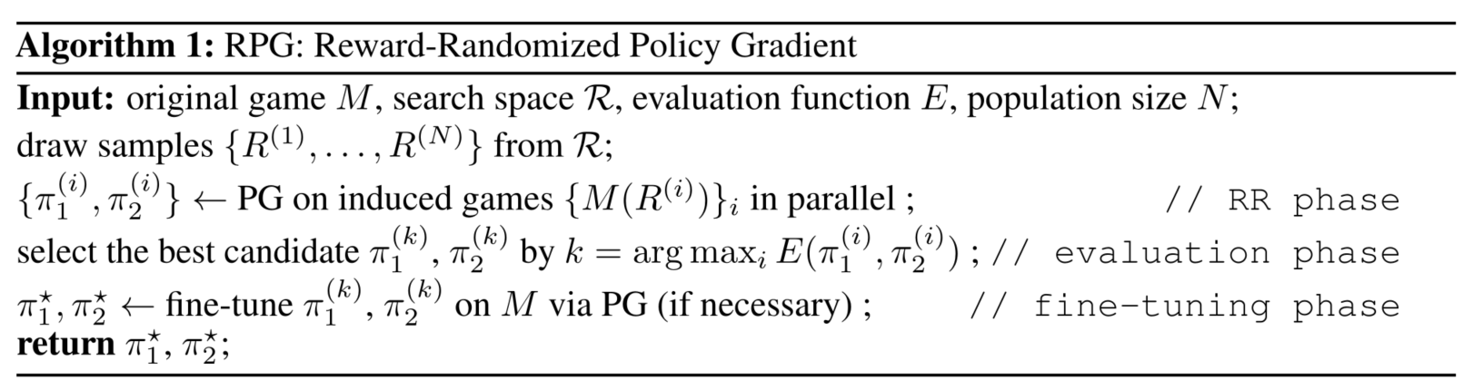
Reward-Randomized Policy Gradient
Multi-Agent Markov games
low-dimensional feature vector
weight

Slide 5
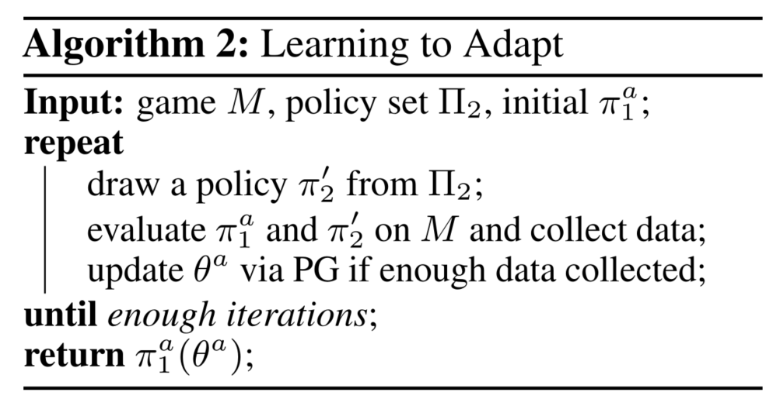
Reward-Randomized Policy Gradient
Learning to adapt with diverse opponents

Slide 6
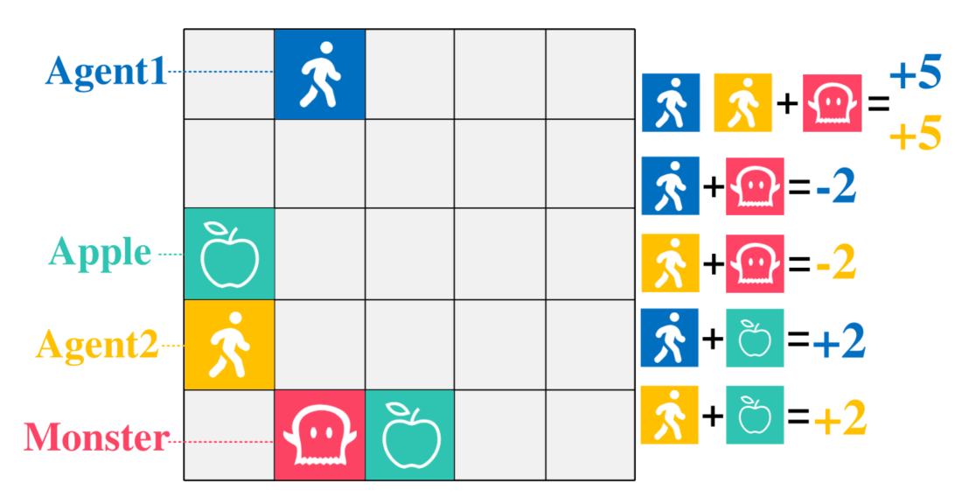
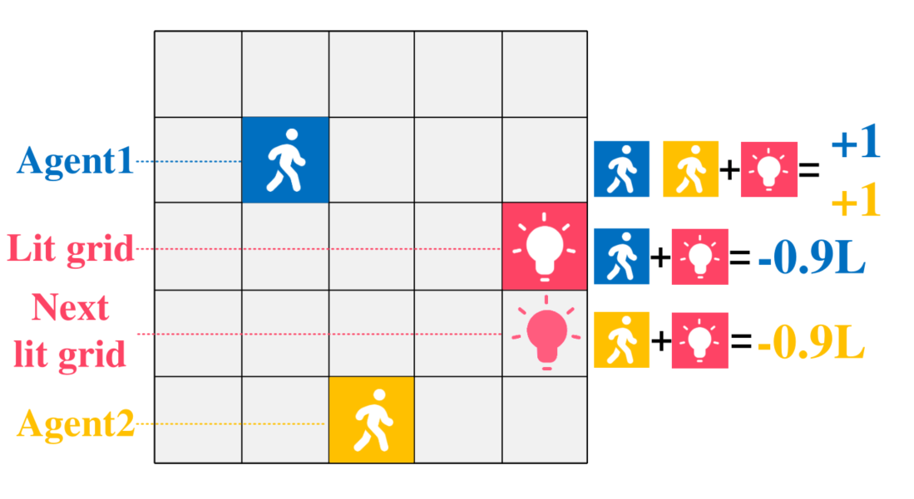
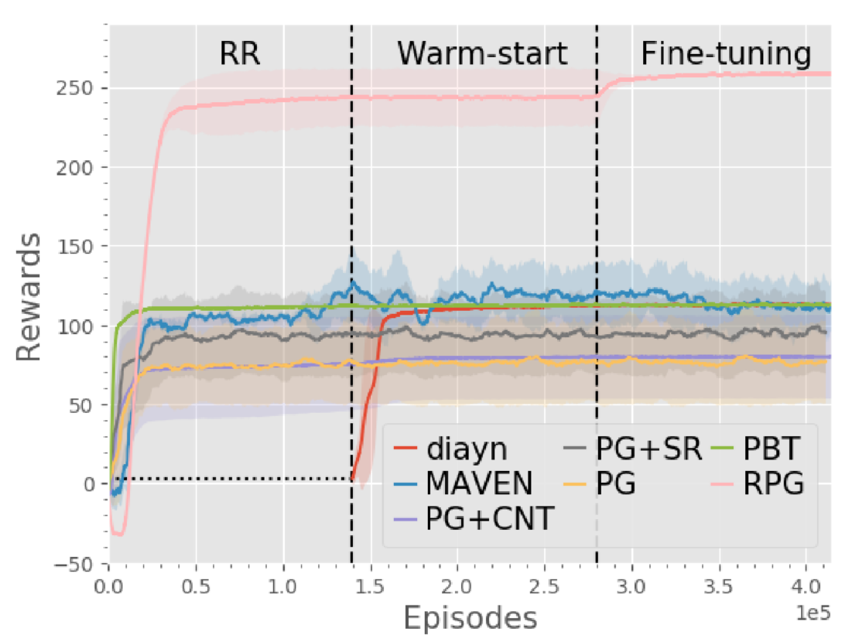
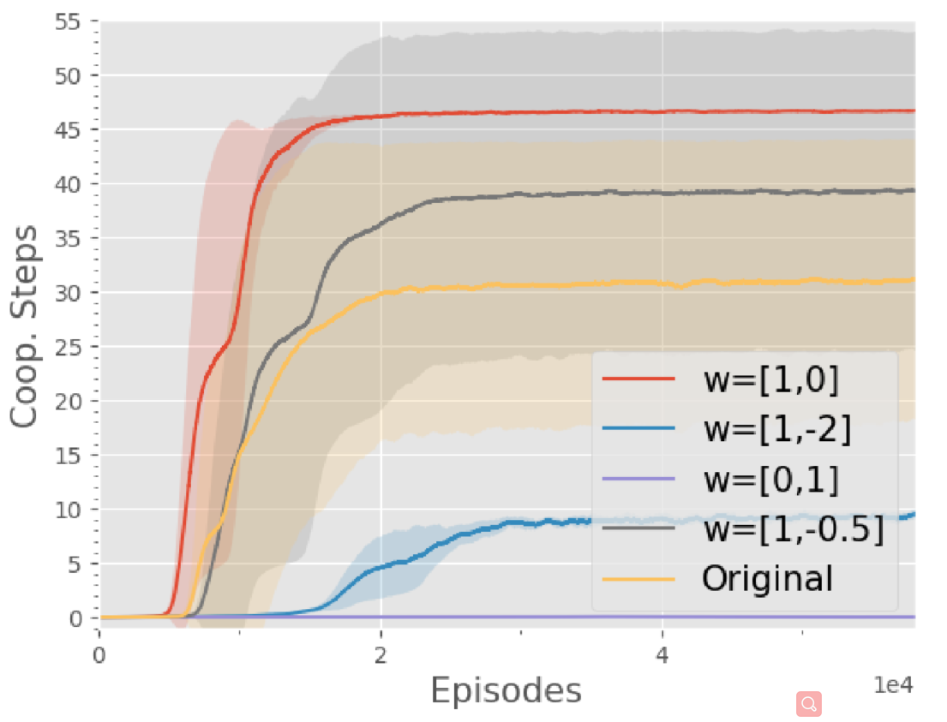
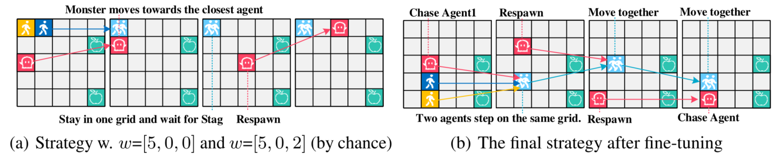

Experimental Results
Monster-Hunt
Escalation

Slide 7
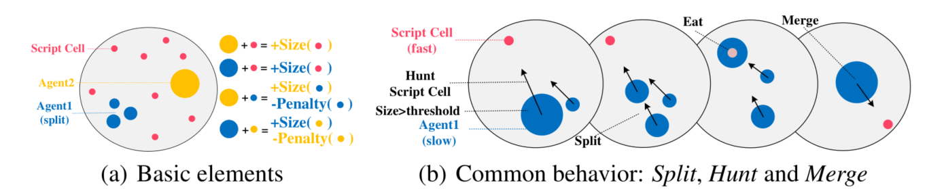
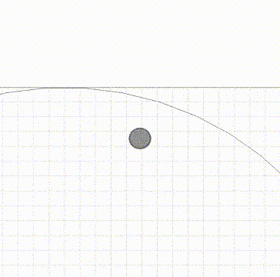
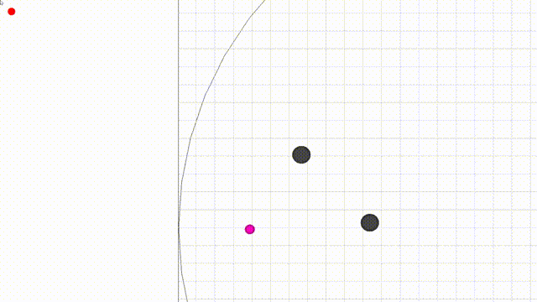
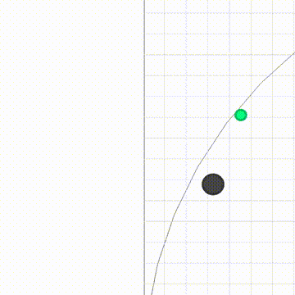
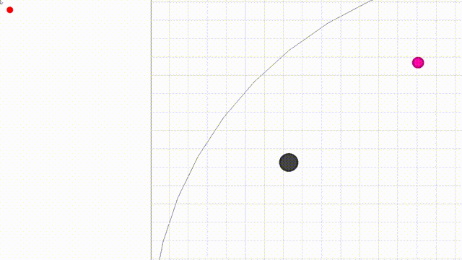
Experimental Results
Non-cooperative strategy
Cooperative strategy
Aggressive strategy
Perpetual strategy

Slide 8
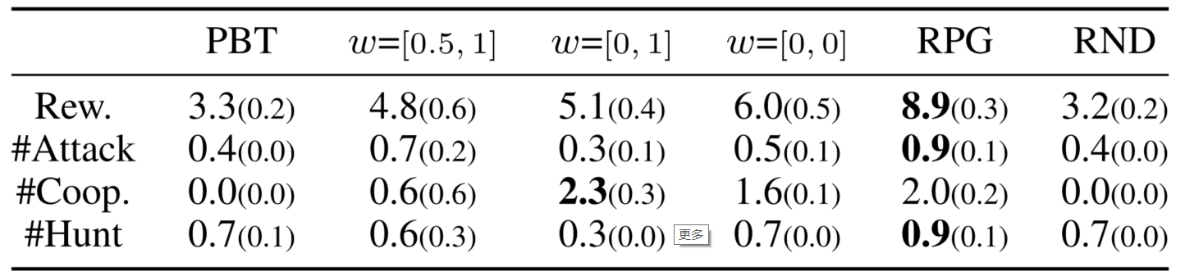

Experimental Results
the bonus for eating the other agent
the prosocial level of both agents

Slide 9
Summarization
A novel reward-space exploration technique, reward randomization (RR), for discovering hard-to-find equilibrium with high payoffs.
RR discovers surprisingly diverse strategic behaviors in complex Markov games, which further provides a practical solution for building an adaptive agent.
A new multi-agent environment Agar .io, which allows complex multi-agent strategic behavior.

